Slide 1
Pitching a Movie Recommender System
From: AI Entertainment
To: Netflix stakeholders

Slide 2

Johnny had a tough Week

Slide 3
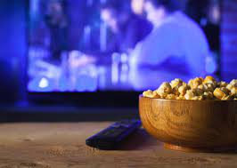
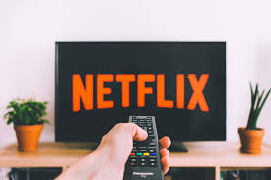

He searches for a movie

Slide 4

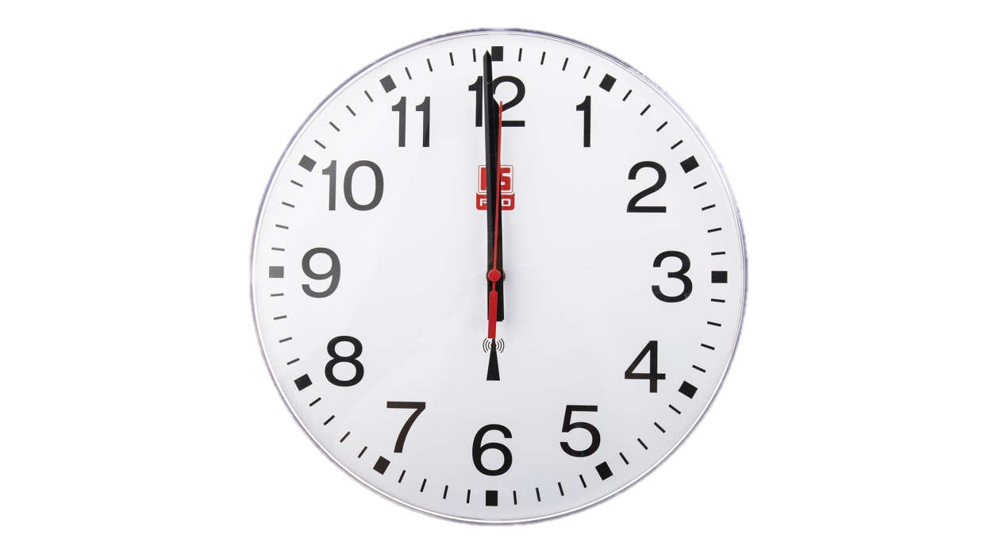
The search is taking long

Slide 5

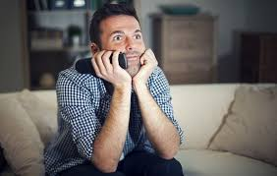
He finds a movie

Slide 6
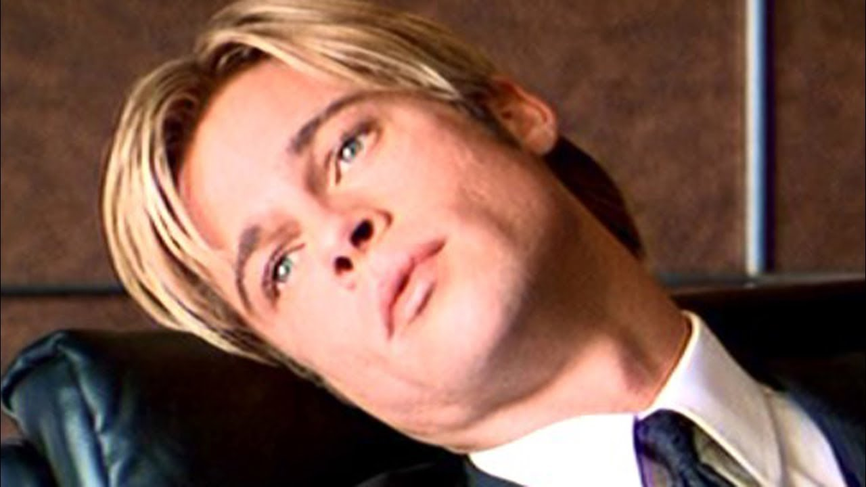
Boredom strikes!

Slide 7
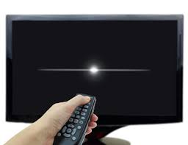
He switches off the TV

Slide 8
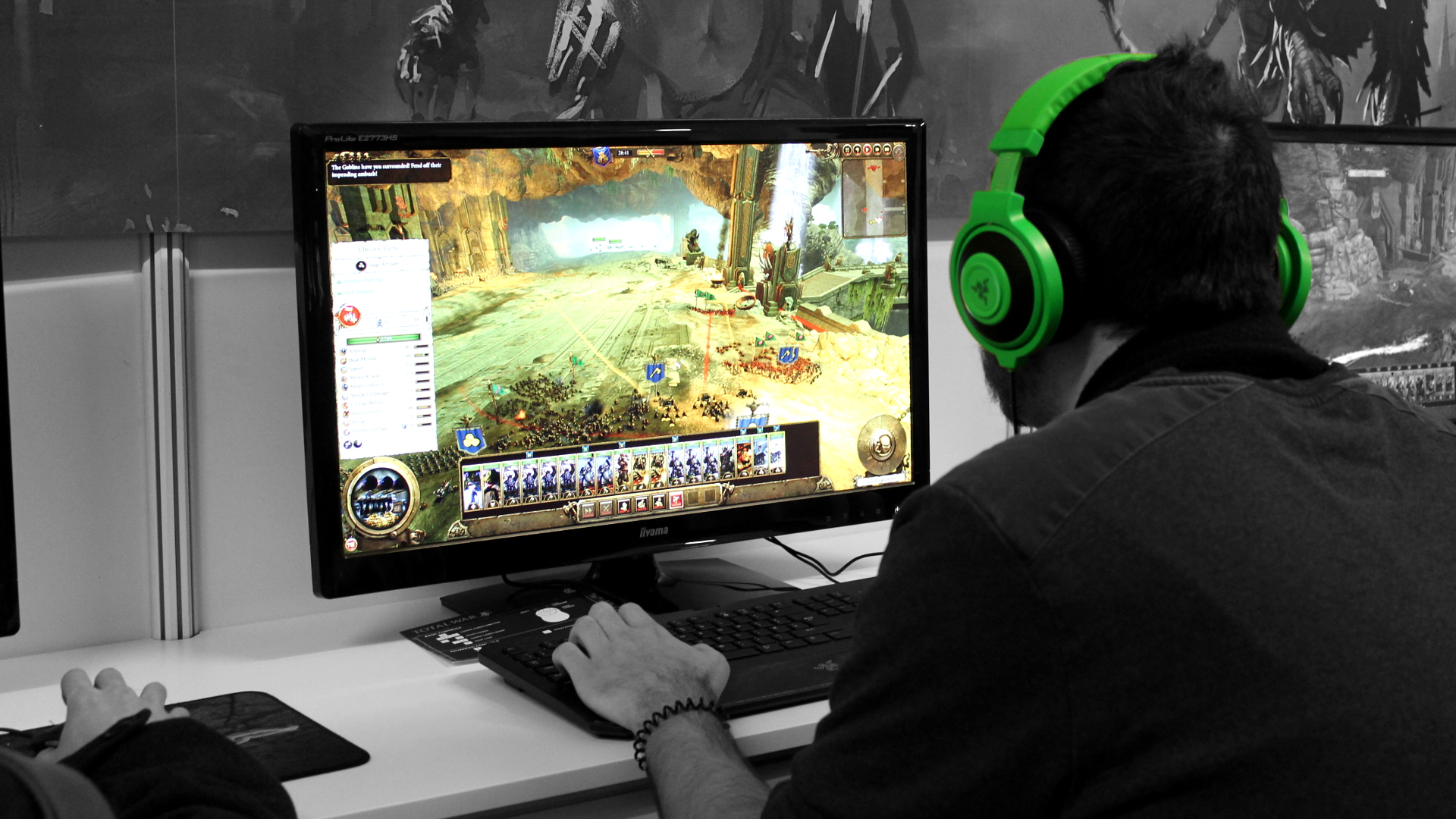
He plays PC games instead

Slide 9
What was Johnny’s problem?
Movie finding took too long
He scrolled passed good movies
He ended watching a movie not suited for his taste.
Johnny’s problem is not unique

Slide 10

How to solve the problem?

